Slide 1





Session 1: Overview Progress, Process, and Issues
Matthew B. Jones
https://orcid.org/0000-0003-0077-4738
@metamattj
https://arcticdata.io
NSF Award #: 1546024
Photo credit: duncan c (http://flic.kr/p/bBtZhy)
Notes:
The NSF Arctic Data Center serves as the primary data and software repository for the Arctic section of NSF Polar Programs. Our mission is to help the research community reproducibly preserve and discover all products of NSF-funded science in the Arctic, including all data, metadata, and software products from Arctic research. Key to the initiative is the partnership between NCEAS at UC Santa Barbara, DataONE, and NOAA’s NCEI, each of which bring critical capabilities to the Center. Infrastructure from the successful NSF-sponsored DataONE federation of data repositories will enable data replication to NCEI, providing both offsite and institutional diversity that is critical to long term preservation. Training and outreach staff will provide hands on training at Arctic research conferences and in dedicated training sessions targeting early-career and under-represented populations. Training and outreach will focus on effective means for long-term data management, following a curriculum being developed and refined by the open science community.

Slide 2
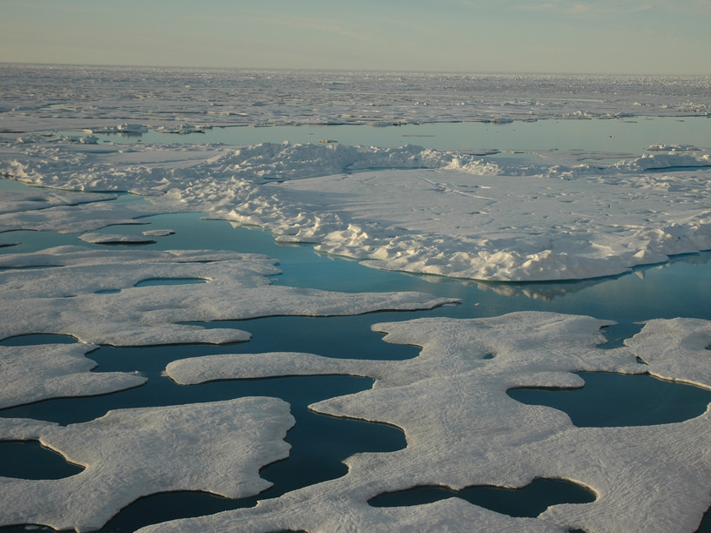
Science Drivers
Photographer: Jeremy Potter NOAA/OAR/OER https://flic.kr/p/8F3Q6M

Slide 3

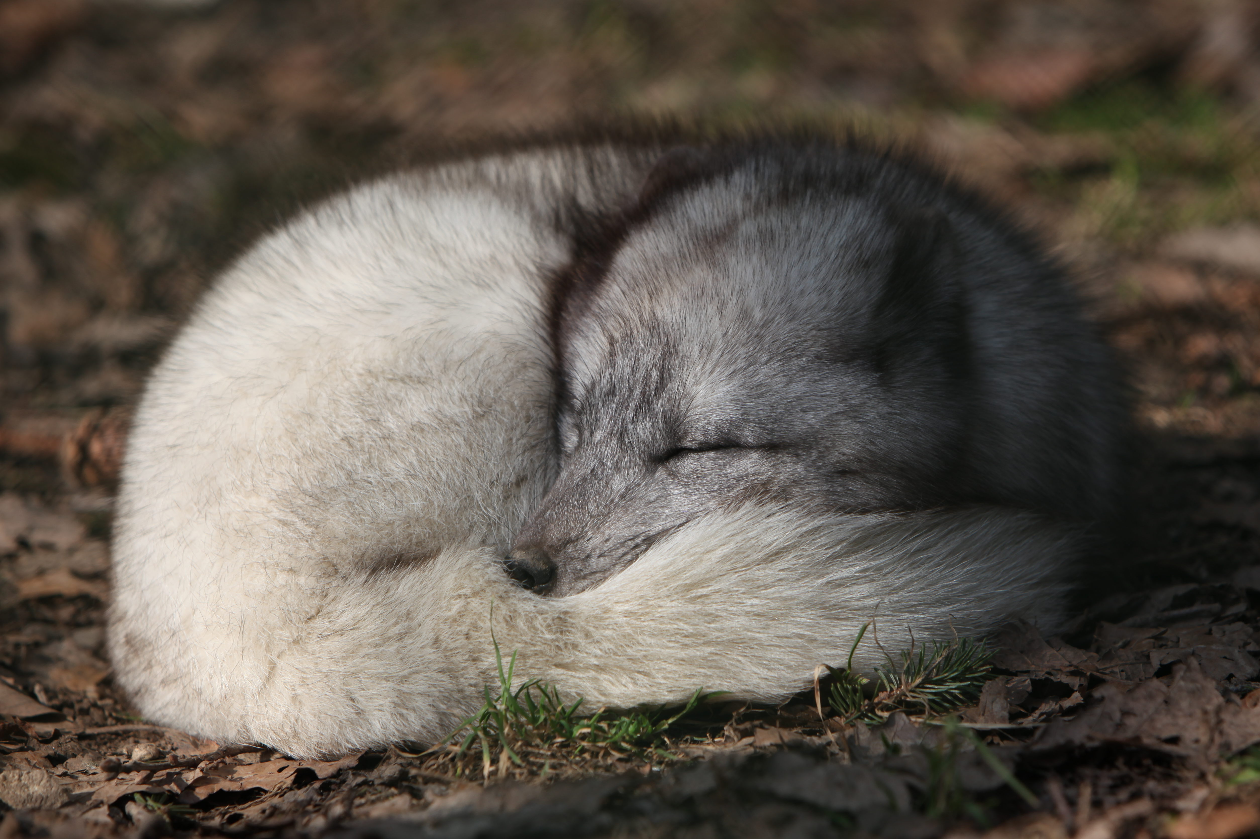
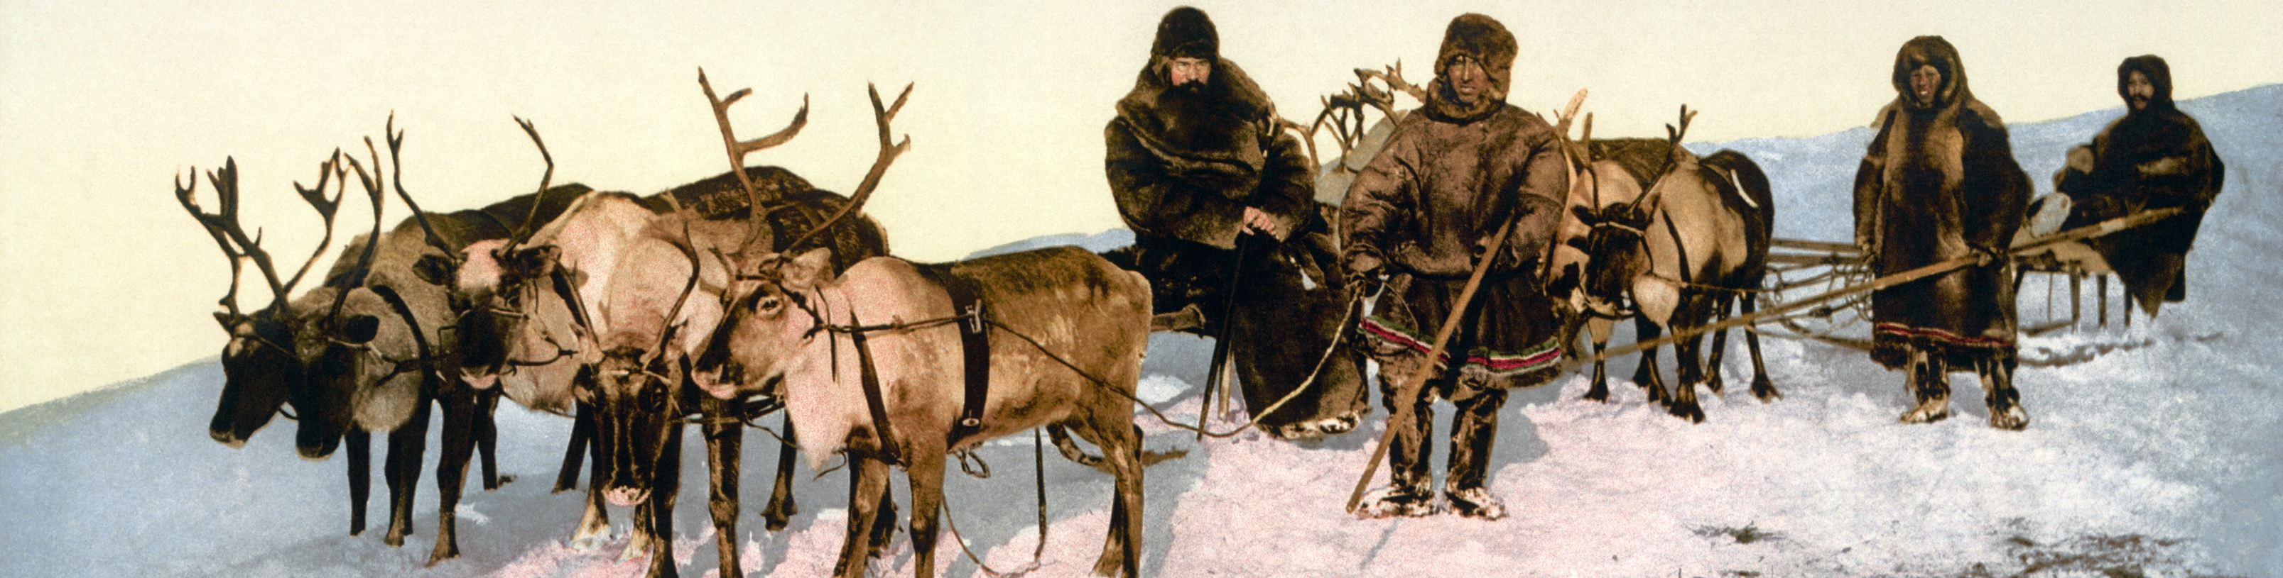
Arctic Research across disciplines
Troms Fylke
Rama
Detroit Publishing Co.

Slide 4
Key Deliverables
Data Archive
Portal for data discovery
Tools for data and metadata submission
Repository cyberinfrastructure
Provenance features
Replication features
Metadata quality check
Support services
Training
Outreach
Overview: http://bit.ly/arctica-summary

Slide 5


Key Deliverables
Data Archive
Portal for data discovery
Tools for data and metadata submission
Repository cyberinfrastructure
Provenance features
Replication features

Slide 6
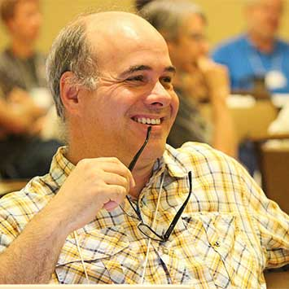
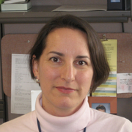
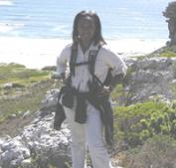
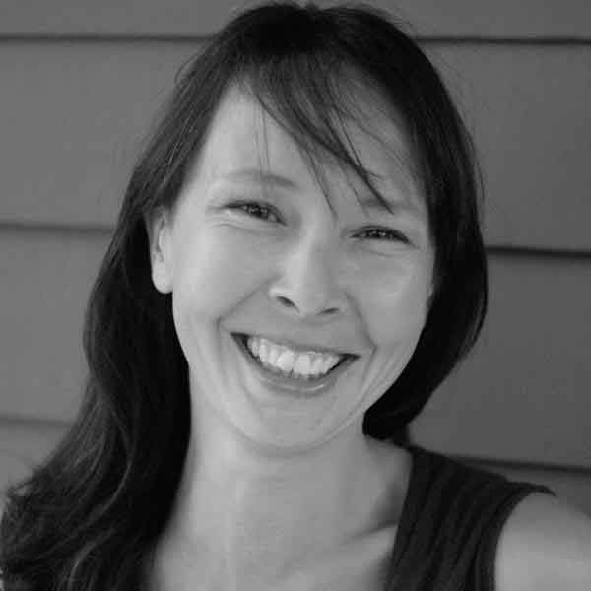
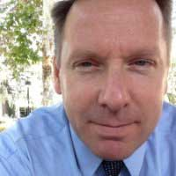
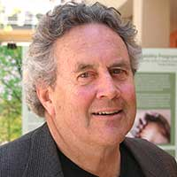
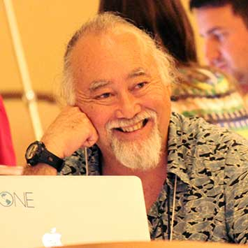
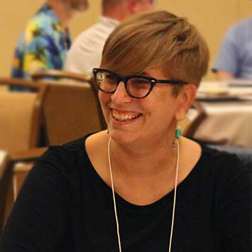
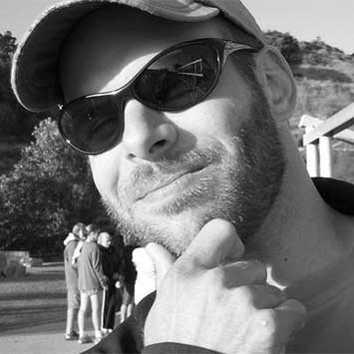
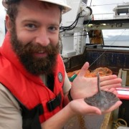
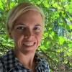
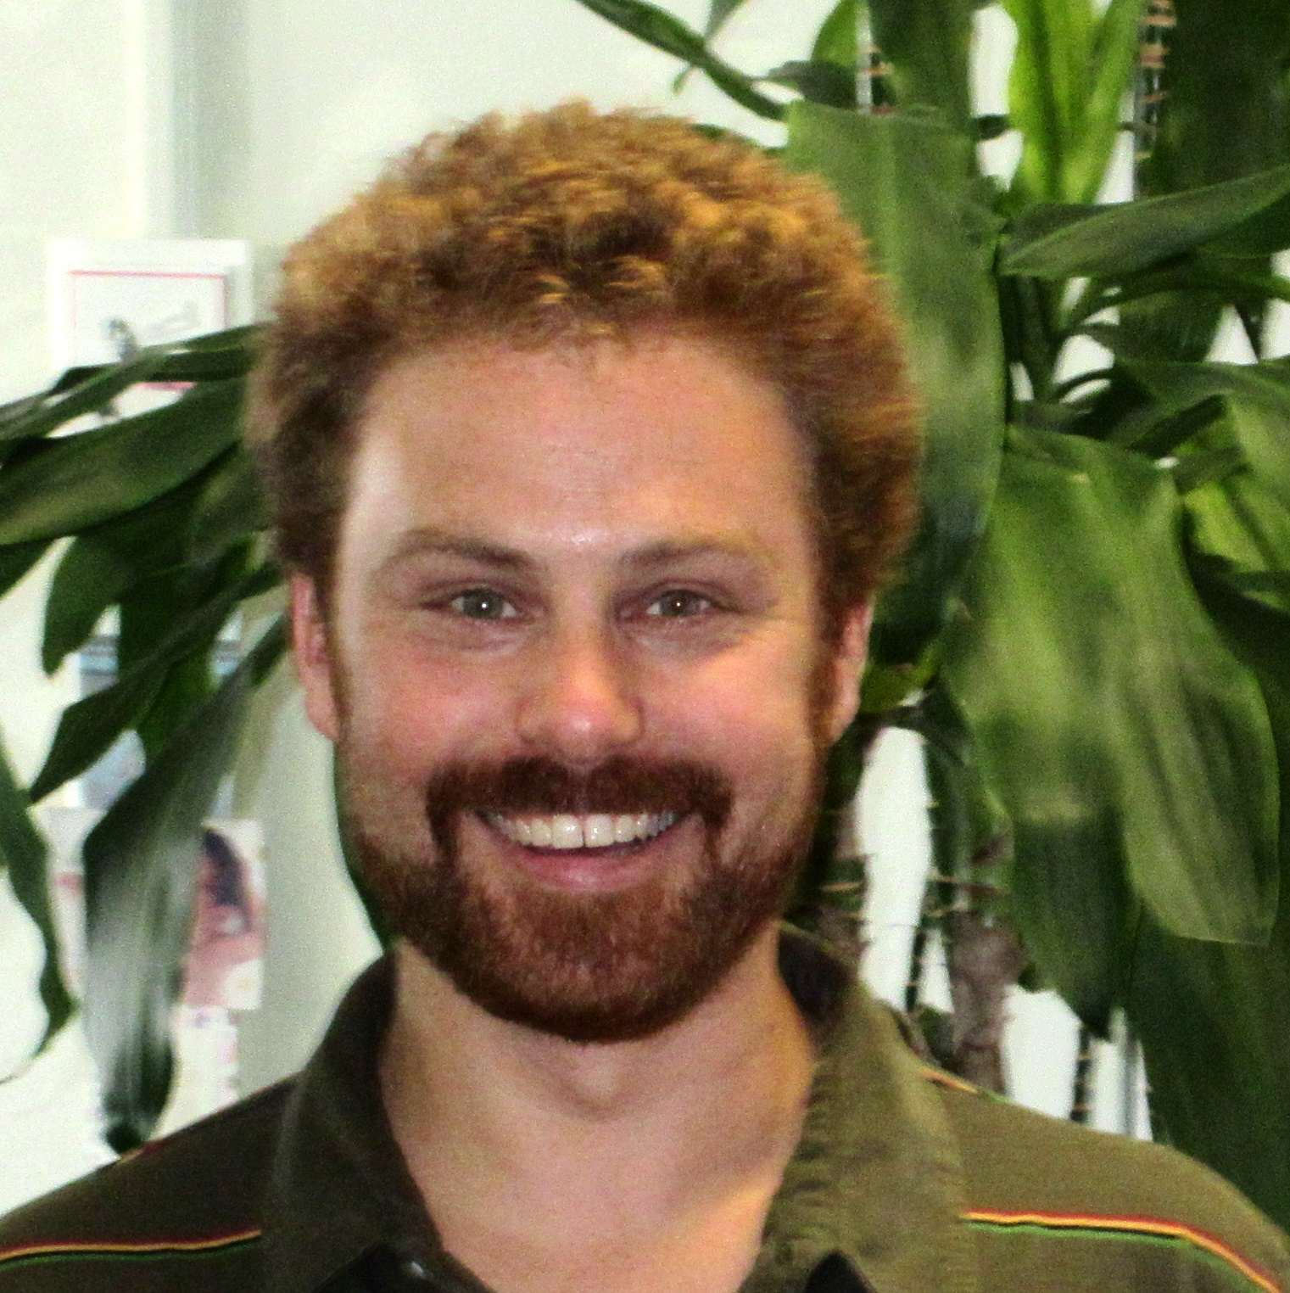
Team
M.Jones
Arzayus
Baker-
Yeboah
Budden
Casey
Dozier
Schildhauer
?
Walker*
C.Jones*
Mecum*
Clark
Goldstein*
Li*
Training*
Student Interns
e.g., J.Graybiel, A.Prescott, I.Su, J.S.Raquel, K.McGill, S.Halperin, S.Lee, A.Gordee, D.Mullen, H.Kim

Slide 7
Cooperative Agreement Highlights
Project Director, Leadership Team
Science Advisory Board
Operational Goals and Objectives
Data services
Community synthesis projects
Education and outreach
Data science fellows
Data management training
Management Plan
NSF oversight and site reviews

Slide 8
Data Preservation
Preserve the bits
Open science, open standards
Replicate data and metadata
Strong versioning
Frequent auditing
https://arcticdata.io/preservation/

Slide 9
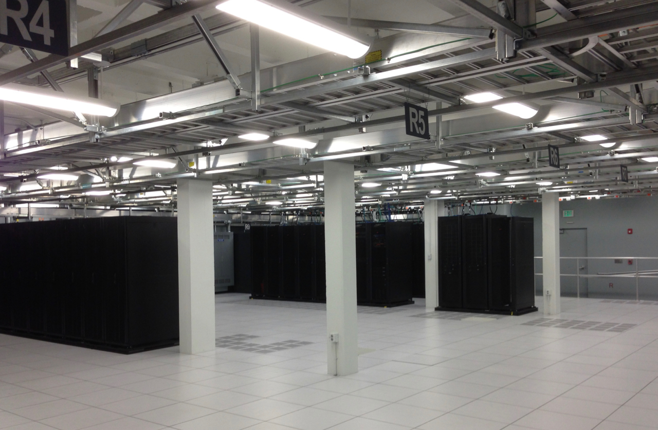
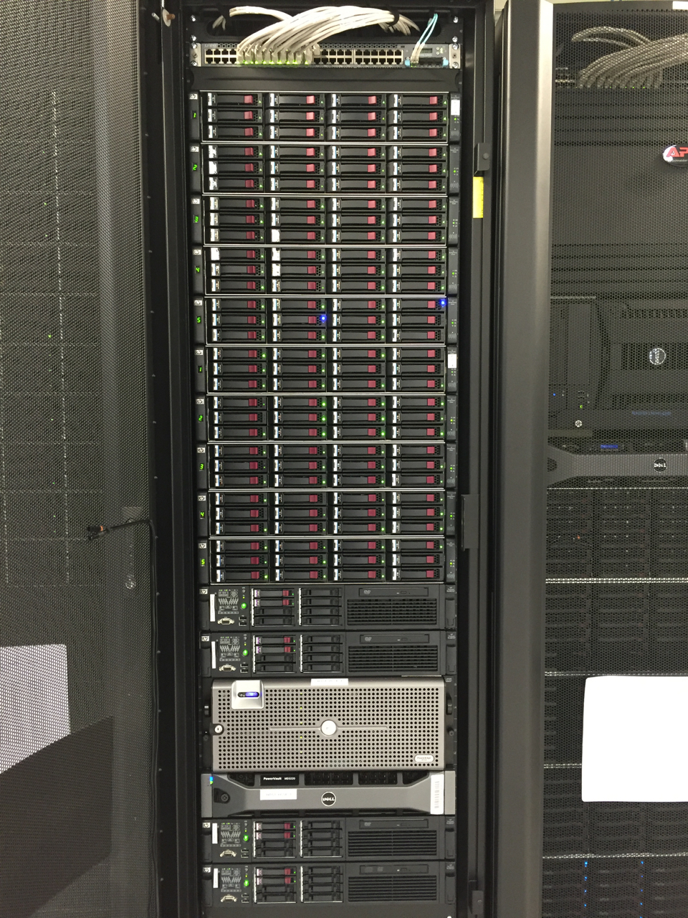
North Hall Data Center
Tier 1 ANSI/TIA Data Center Standards
Redundant networking at 10GbE
Power backup: Room UPS plus generator
Cooling: campus chilled water loop + chillers

Slide 10





Operation Metrics
4,700+ data sets
2,000 creators
642K data files
4,600+ USERS
13.94 TB Data Storage
71K+ file downloads
Notes:
1,151 new and changed data sets
Users: unique people accessing metadata and data
https://docs.google.com/document/d/1CMpwAlbI7cIF8sDcOod9v4Vq1X2XhHZhKsqApfrdz0A/edit#heading=h.gjdgxs. page 6

Slide 11
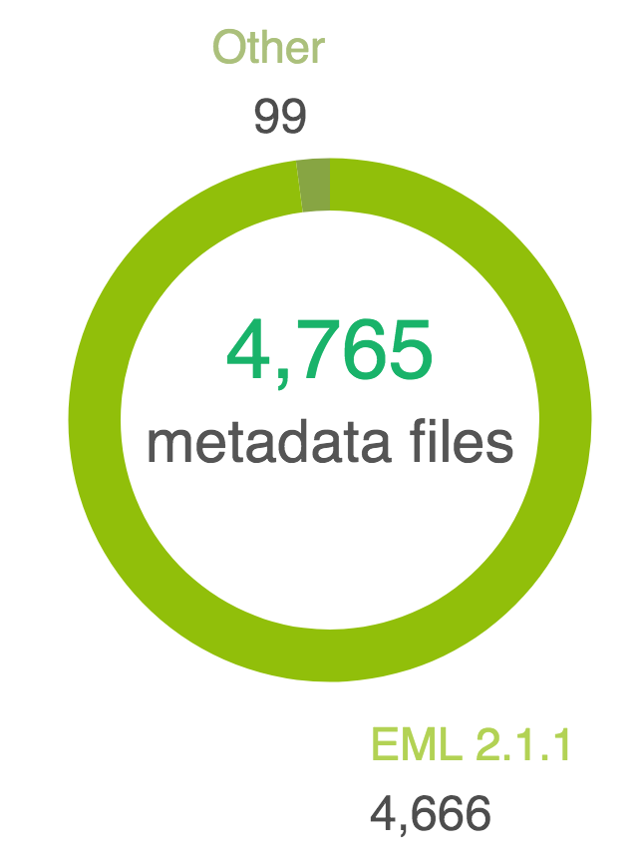
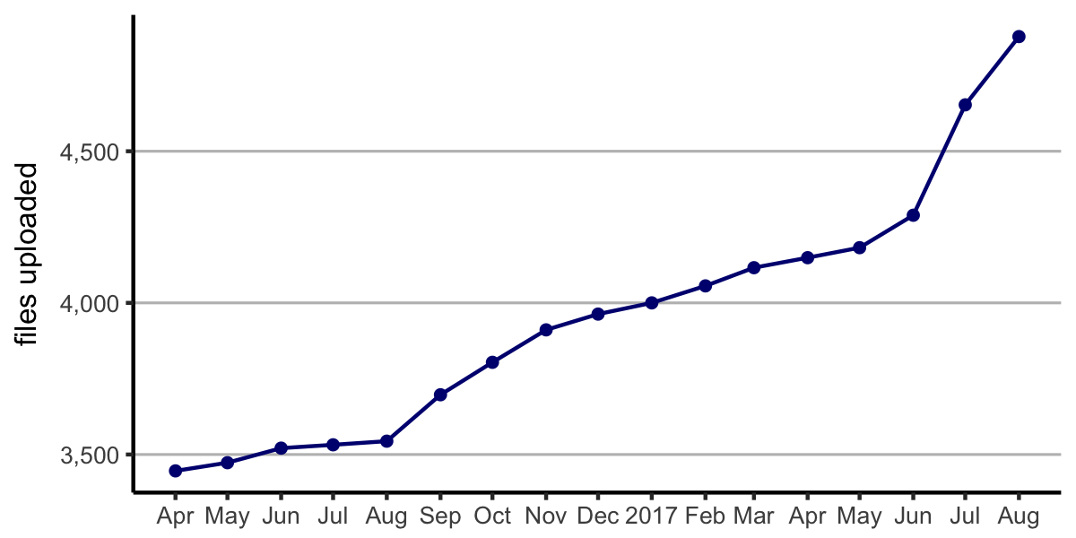
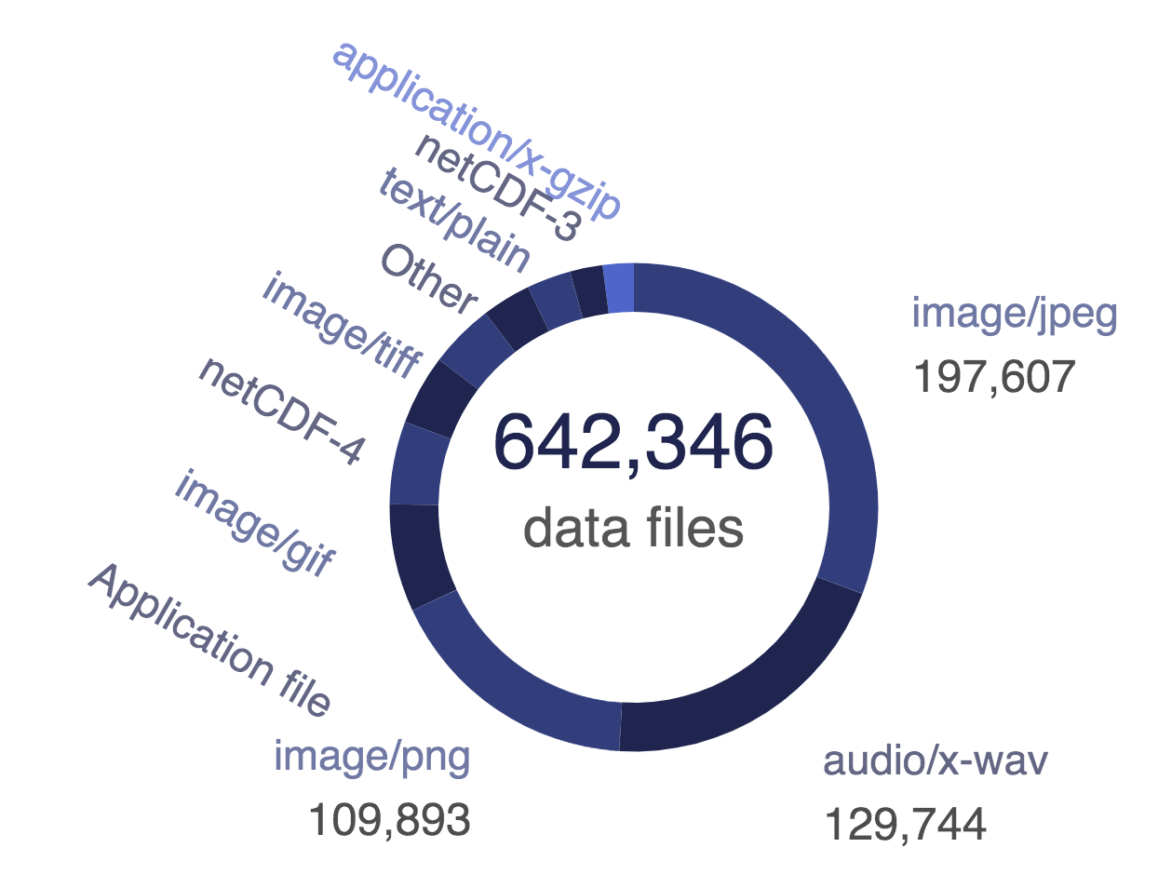
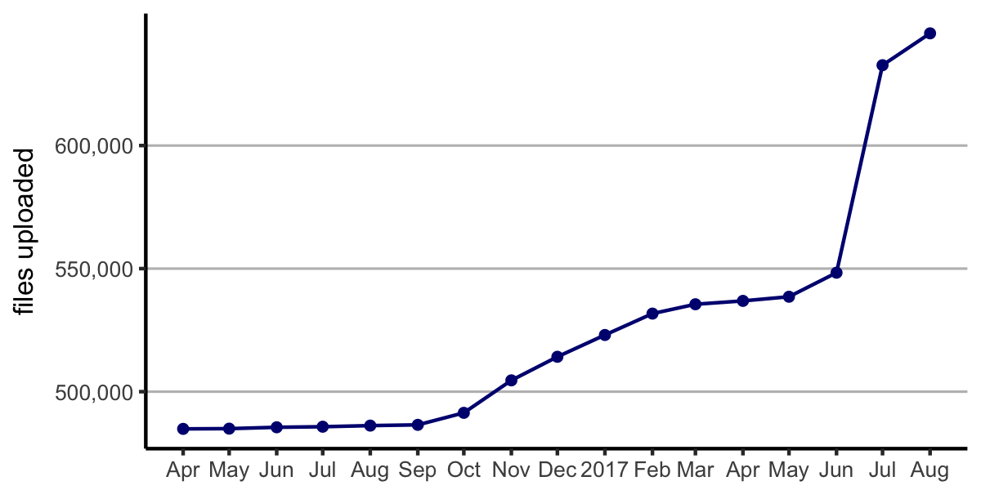
Data archive growth

Slide 12
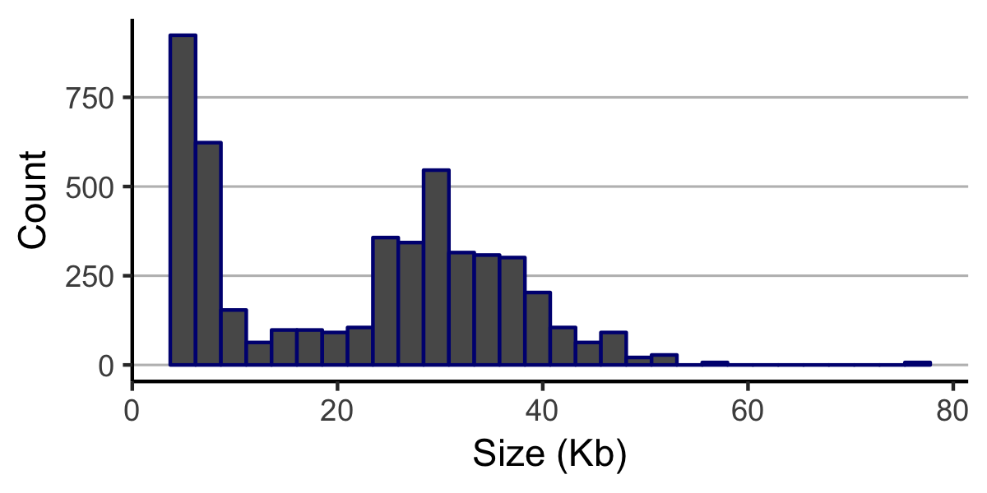
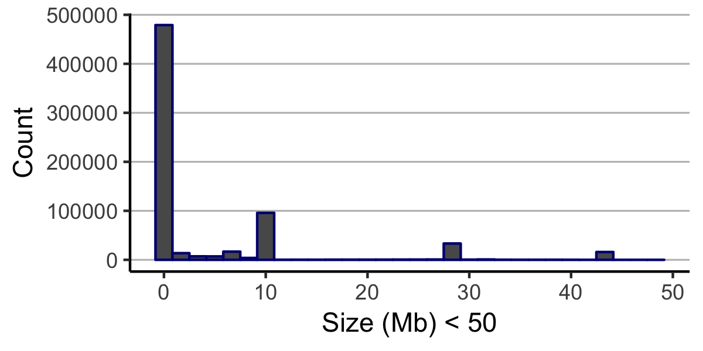
Size distribution
Metadata
Data
(< 50MB)

Slide 13
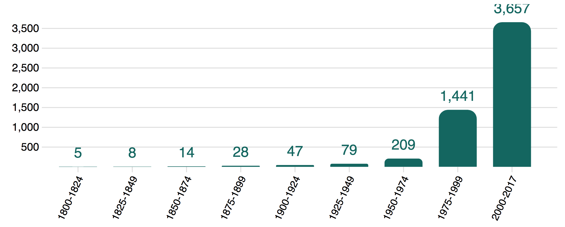
Data by time period

Slide 14
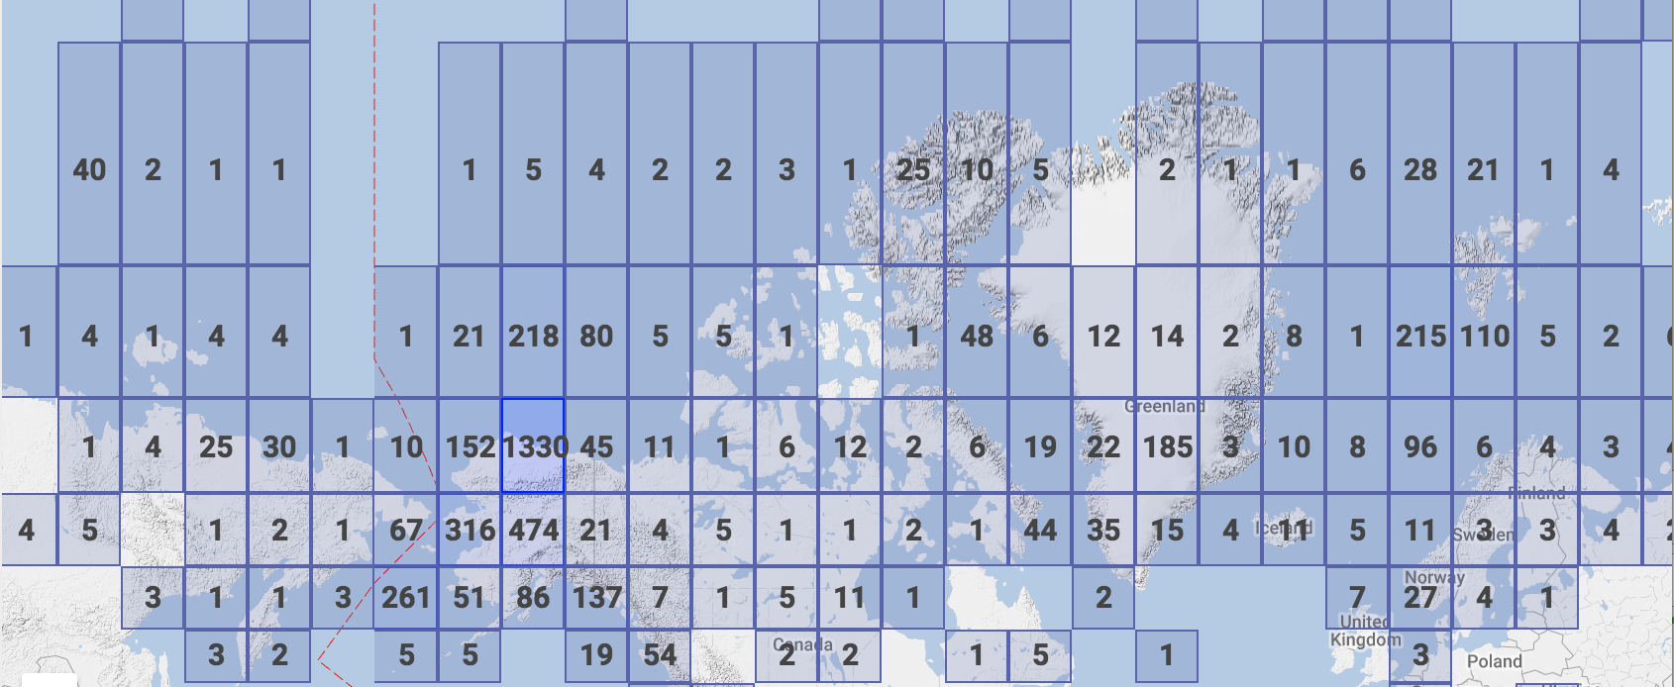
Pan-Arctic Data

Slide 15
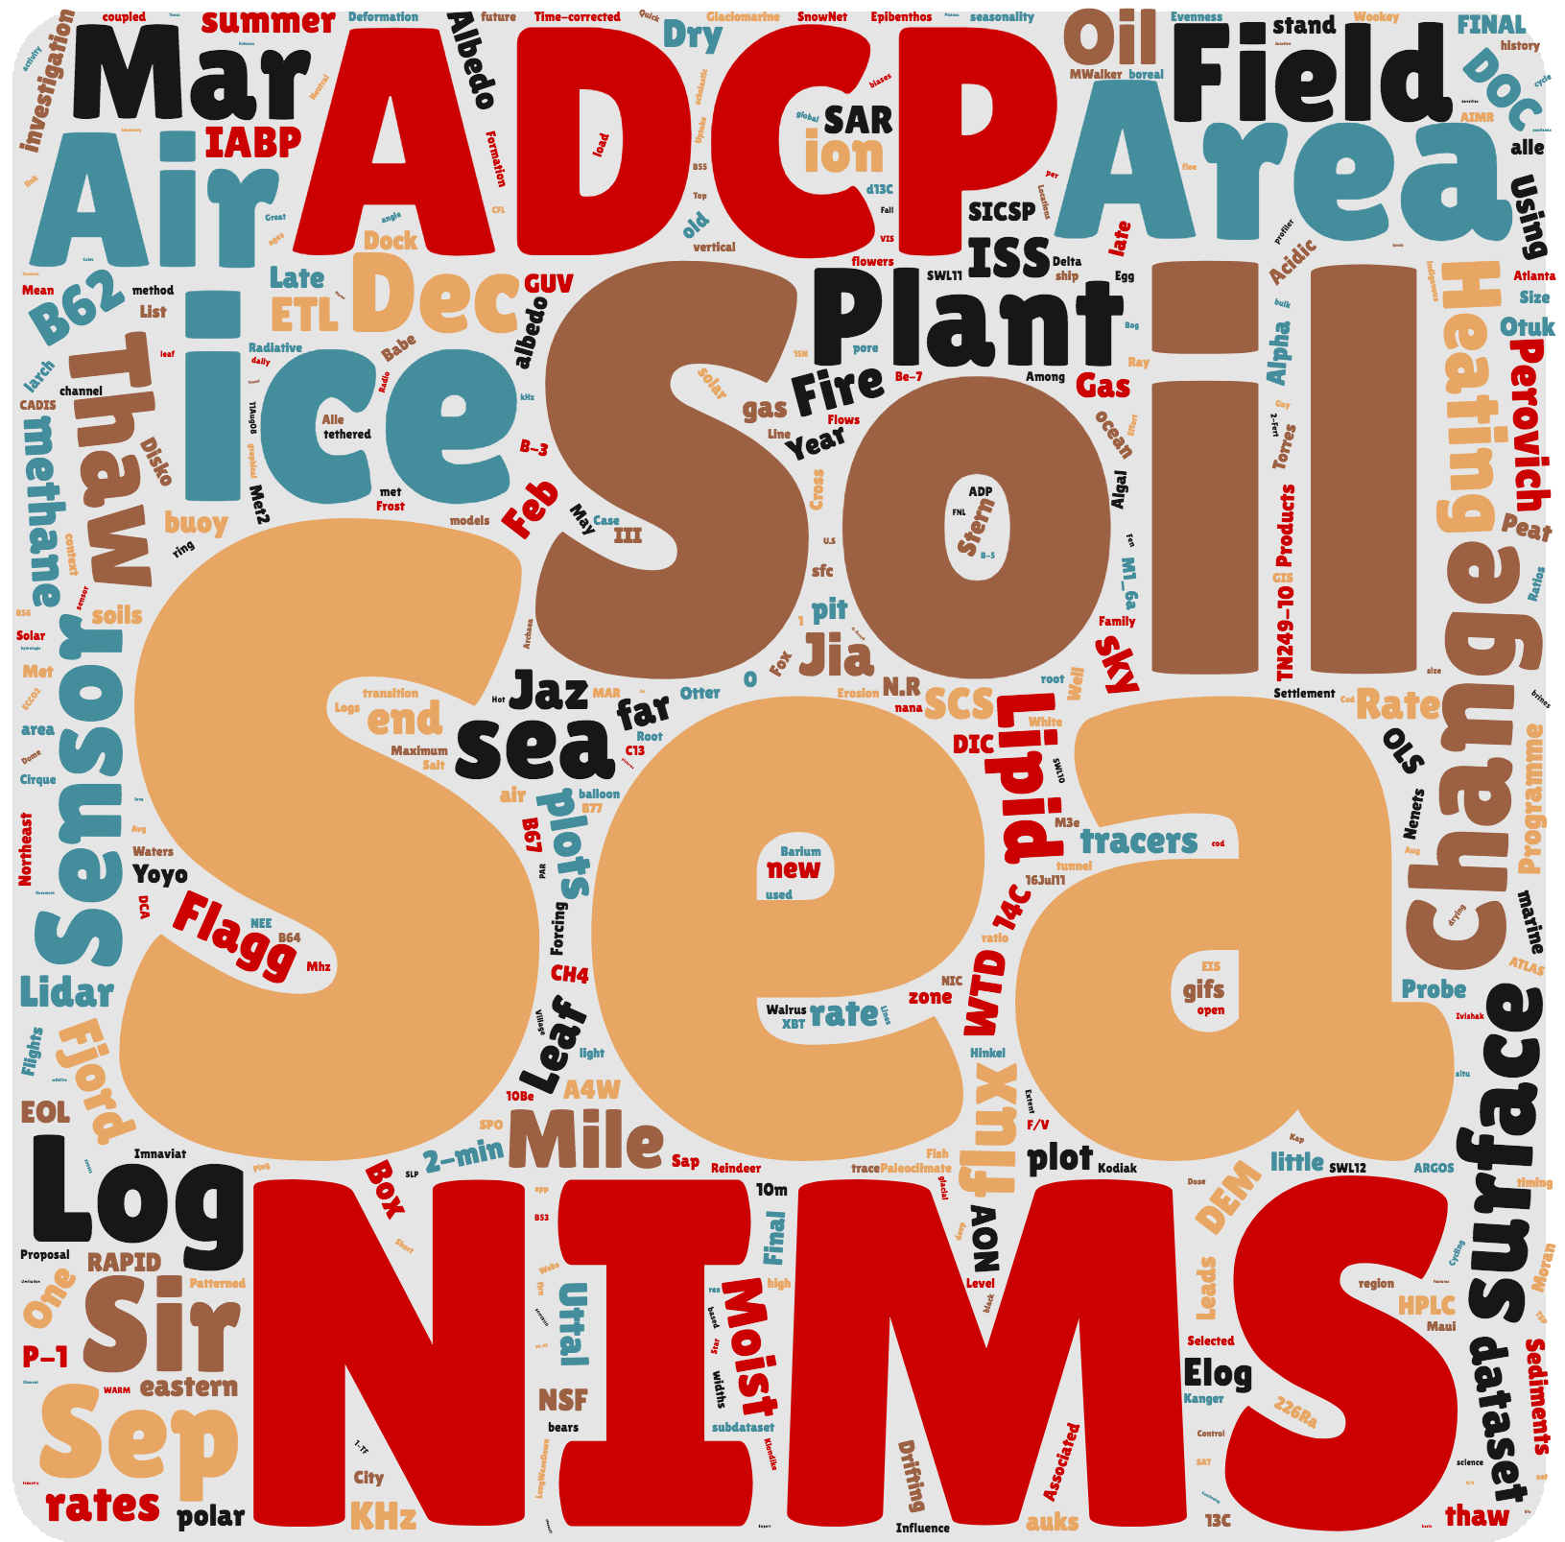

Slide 16
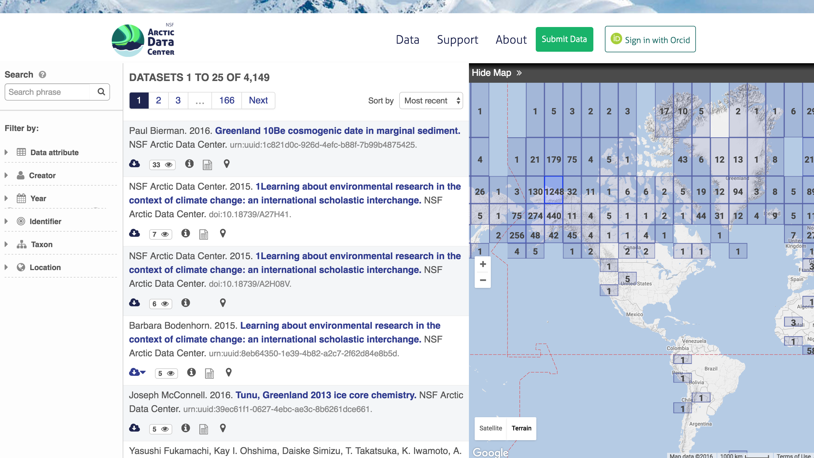
Data Discovery Portal

Slide 17


Terms of Use: Licensing and Distribution
https://arcticdata.io/submit/#license
All metadata and (non-sensitive) data will be released under either:
CC-0 Public Domain Dedication:
“… can copy, modify, distribute and perform the work, even for commercial purposes, all without asking permission.”
Creative Commons Attribution 4.0 International License:
“… free to… copy,… redistribute,…
remix, transform, and build upon the material for any purpose, even commercially,… [but] must give appropriate credit, provide a link to the license, and indicate if changes were made.”
ACADIS | Standards | Systems | Metrics | Discussion
Notes:
Potential exception: social science data that have certain sensitivities related to privacy or confidentiality. In cases where legal (e.g., contractual) or ethical (e.g., human subjects) restrictions to data sharing exist, requests to restrict data publication must be requested in advance and in writing and are subject to the approval of the NSF, who will ensure compliance with all federal, university, and Institutional Review Board policies on the use of restricted data.
No complaints about this choice, shows a willingness to participate in very OPEN sharing policies.

Slide 18
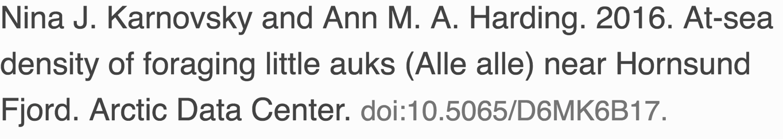
Data Citation
We assign a DOI to each published data set
Researchers should cite data they use
We are working with DataCite to track the citations to data
To be displayed next year

Slide 19
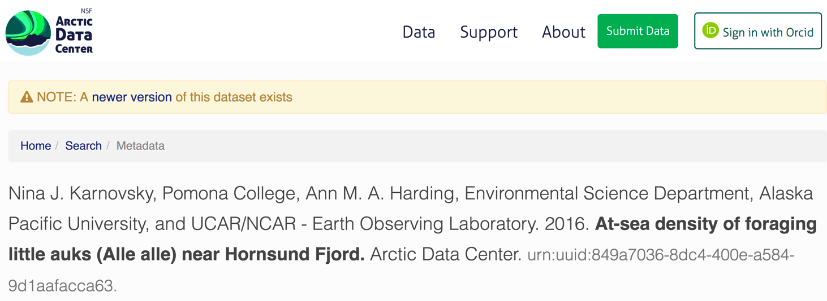
Versioning
Each update has a unique identifier
Cite the exact version used
Newer versions are clearly indicated

Slide 20
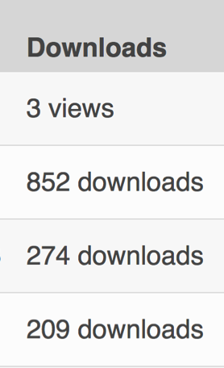
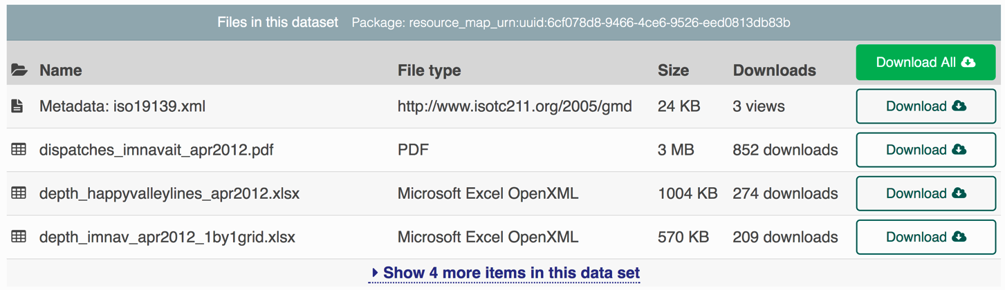
Data usage counts

Slide 21
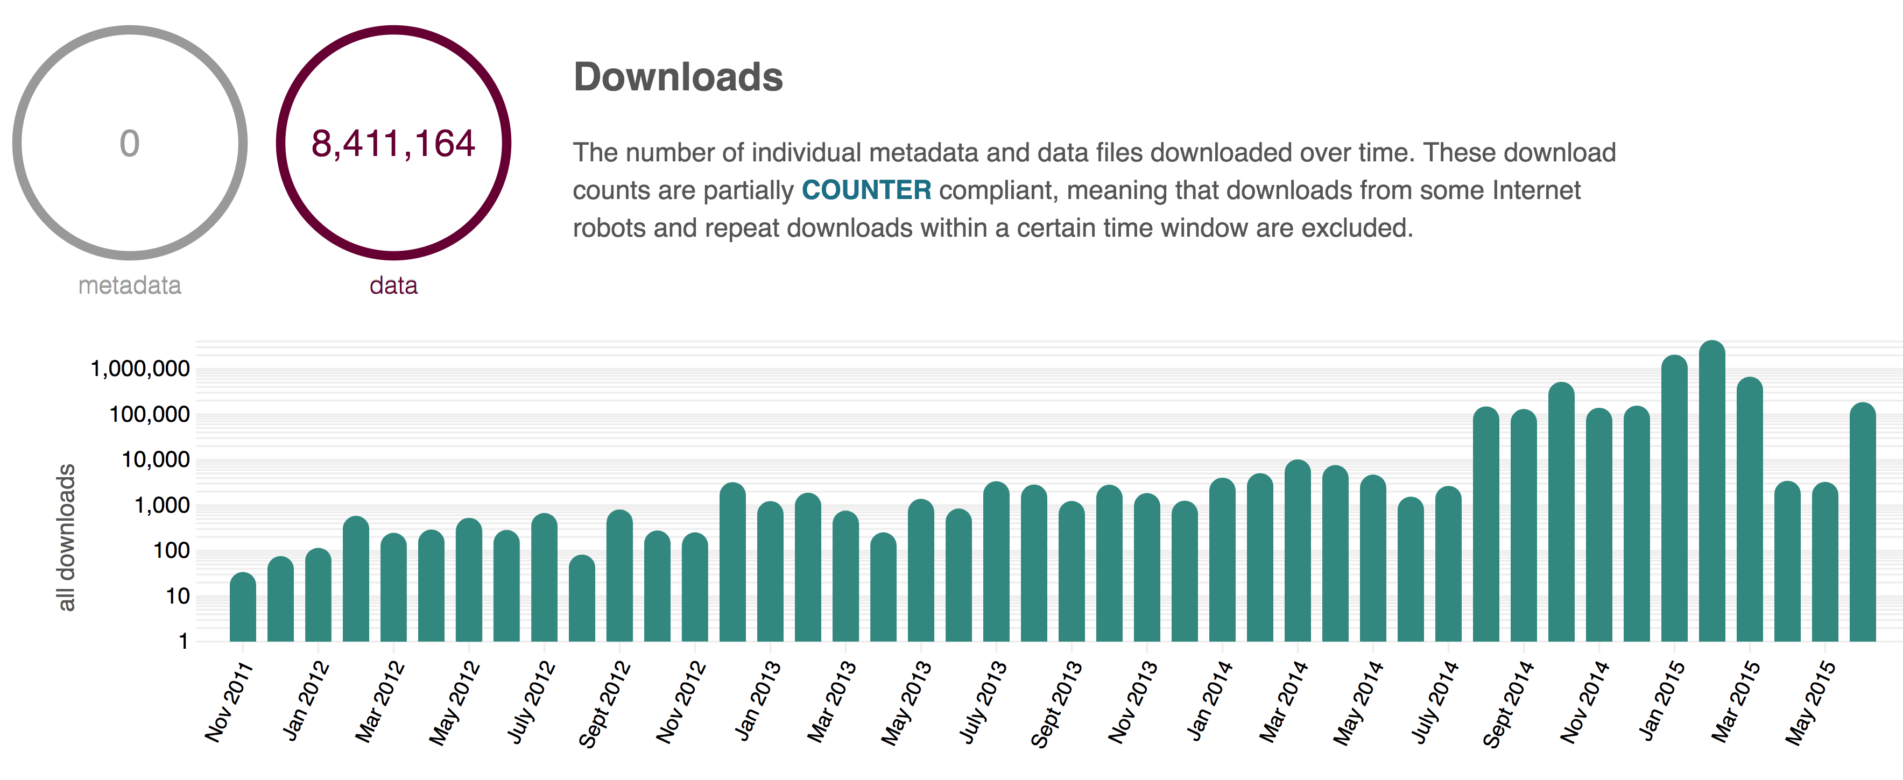
Downloads over time

Slide 22
Milestones: Year 1
Cyberinfrastructure | ✓ | CI-1: Launch initial system
 | ✓ | CI-2: Prototype content replication
 | ✓ | CI-3: Improve data portal
 | ✓ | CI-4: Customize web submission
 | ✓ | CI-5: Deploy client tools
Support Systems | ✓ | SS-1: Deploy support infrastructure
 | ✓ | SS-2: Repository operation
 | ✓ | SS-3: Support Data Management Planning
Community Engagement | ✓ | CE-1: Build public website
 | ↻ | CE-2: Create Data Science fellowship
 | ↻ | CE-3: Conduct training
 | ↻ | CE-4: Conduct synthesis project

Slide 23
Milestones: Year 2
Cyberinfrastructure | ↻ | CI-6: Operate and maintain infrastructure systems
 | ↻ | CI-7: Production content replication
 | ↻ | CI-8: Improve data portal
 | ↻ | CI-9: Customize web submission
 | ↻ | CI-10: Deploy client tools
Support Systems | ↻ | SS-4: Ongoing user support
 | ↻ | SS-5: Ongoing data recovery
 | ↻ | SS-6: Ongoing data management planning support
Community Engagement | ↻ | CE-6: Refine public website
 | ↻ | CE-7: Operate Data Science fellowship
 | ↻ | CE-8: Conduct training
 | ↻ | CE-9: Conduct synthesis project

Slide 24
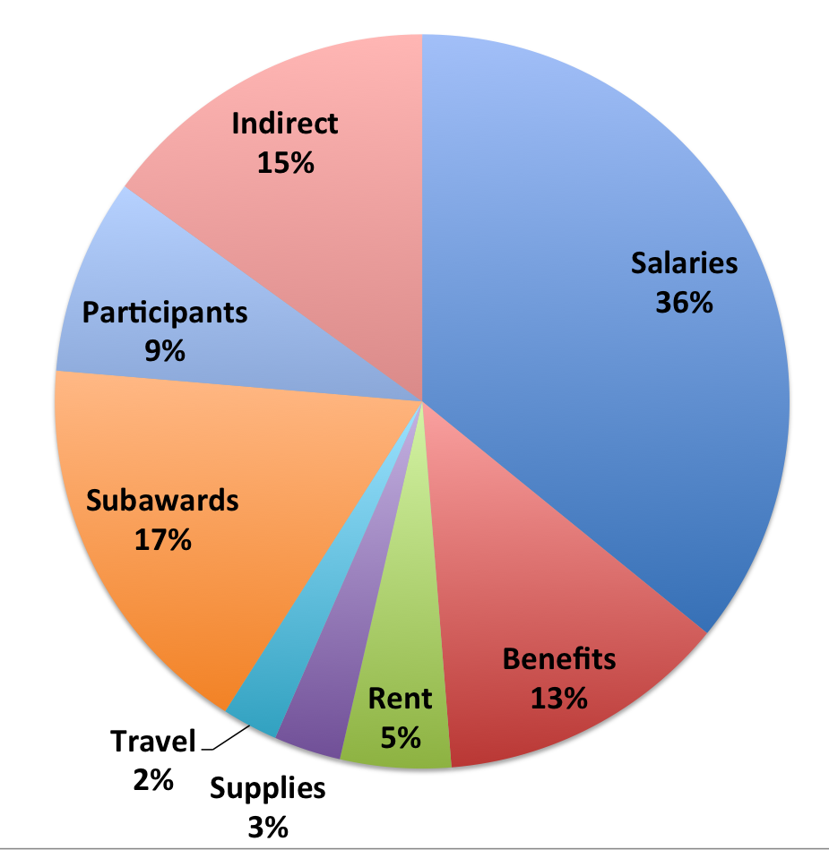
Budget breakdown
Budget ~$1.2M/yr
Underspending
Hiring
Student interns
Data Science Fellowships

Slide 26
Agenda
Monday
Session 1: Overview
Session 2: Infrastructure (with eclipse break)
Session 3: Support Services
Session 4: Arctic Data Semantics
Session 5: Arctic Synthesis
Session 6: Community Engagement
Session 7: Q&A with NSF
Session 8: Training
Session 9: Supporting social science data
Session 10: Final discussion
Tuesday

Slide 27
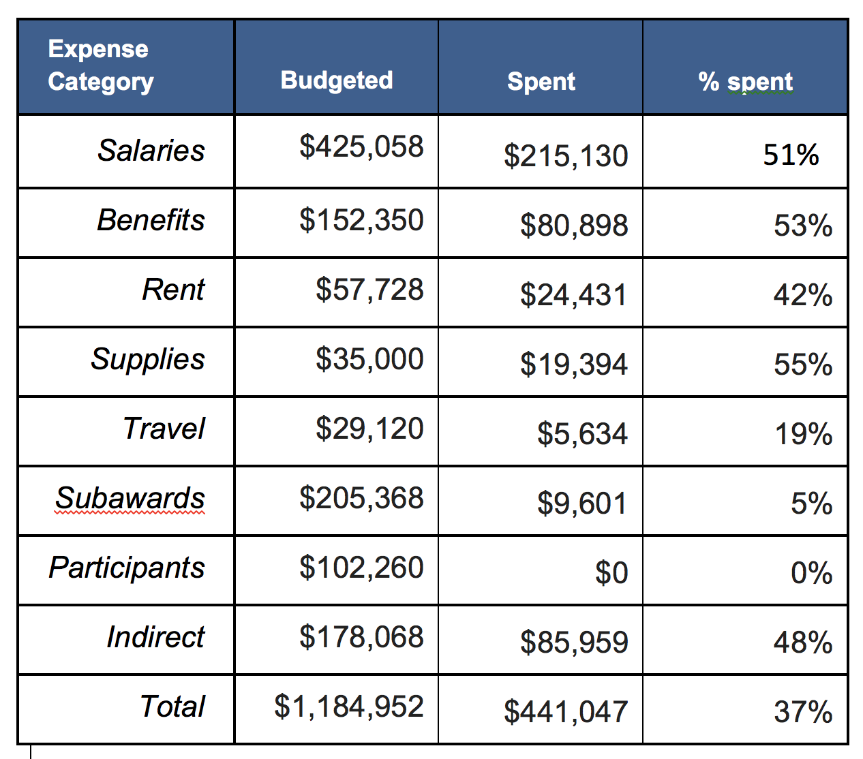
Year 1: Spending breakdown

